Slide 1
Longest increasing subsequences in sliding windows
Michael H. Albert, Alexander Golynski, Angele M. Hamel,
Alejandro Lopez-Ortiz, S. Srinivasa Rao, Mohammad Ali Safari
Theoretical Computer Science 321 (2004) 405–414
Presenter: Yung-Hsing Peng
Date: 2005.04.19

Slide 2
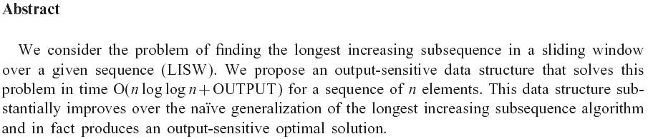

Slide 3
Definition for the Problem
Local Max Value
For each window report the length k of the longest increasing subsequence in that window.
Local Max Sequence
Explicitly list a longest increasing subsequence for each window
Global Max Sequence
Find the window with the longest increasing sequence among all windows.
*The algorithm in this paper deals with the second problem

Slide 4
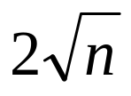
Previous Work (no sliding)
Average length of LIS is
Robinson-Schensted-Knuth Algorithm
O(nlogn) for finding the LIS, which is optimal in comparison model
van Emde Boas data structure
O(nloglogn) for finding the LIS using a special data structure.
These previous works will be used to describe the new algorithm.

Slide 5
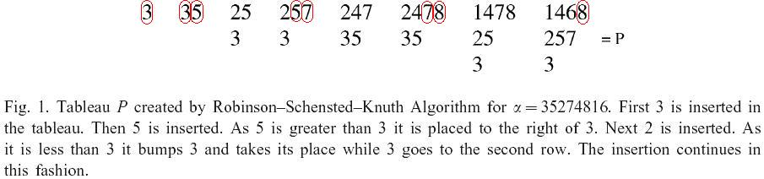
Robinson-Schensted-Knuth Algorithm
We can trace the LIS using an implicit tree if we record the left neighbor of when an element is inserted.

Slide 6
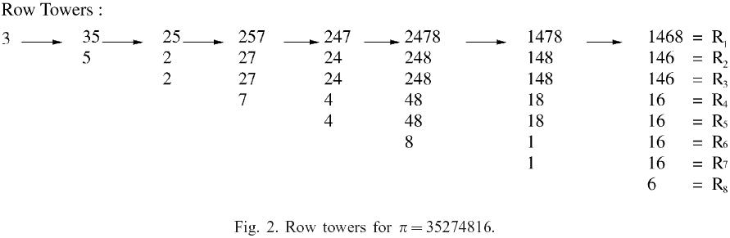
Data Structure in This Paper

Slide 7
Efficient Method to Maintain the Row Towers
(1) m Sequence (run length coding)
→ Used to delete duplicate rows
(2) d Sequence
→ Used to record the valid range of every element
(3)σSequence
→ Used to record the valid range of every element when the tower is run length coded. (It will also be used when tracing the LIS sequence)
(4)Principle Row
→ Used to maintain every element (It is the result of RSK algorithm, but using Emde Boas data structure to keep them will only cost O(nloglogn))

Slide 8
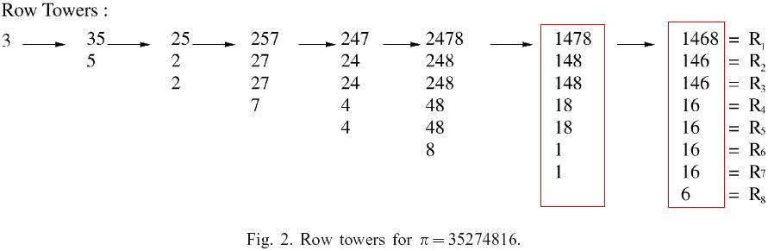
An Example
PR = (1,4,7,8)
m = (1,2,2,2)
d = (7,3,1,5)
σ= (4,2,1,3)
PR = (1,4,6,8)
m = (1,2,4,1)
d = (7,3,8,1)
σ= (3,2,4,1)

Slide 9
Some Important Tips
R_{i} includes R_{i+1}, and only differs from R_{i+1} by at most one element.
σ is the permutation from 1 to l, where l is the length of LIS in this window
When a new element is inserted, d and σ can be updated by replacing and shifting some elements.

Slide 10
Updating the Row Towers (1/2)
Expire
The expire operation simply subtracts 1 from each element of d and deletes the element with expiry time 0 (if there is one) from R. If no deletion occurs then σ is unchanged. Otherwise, the element 1 is deleted from σ and the remaining values are decreased by 1.
→ This operation cost O(l), where l is the length of LIS in the processing window

Slide 11
Updating the Row Towers (2/2)
ADD (new element b)
So there is a sequence of indices i₁<i₂<· · · <i_{k} for the sequence d defined as follows: i₁ is the least index of an element of the principal row which is larger than b (if no such index exists, then the sequence is empty), and i_{t+1} is the least index larger than i_{t} for which d(i_{t+1})>d(i_{t} ). These indices represent the elements of the principal row which are bumped by b. Since b is placed in position i₁ in the first row and does not drop out until the very end, the sequence d is updated according to:
d(i_{t+1}) = d(i_{t}) for t = 1,2… k-1, (means “shift”)
d(i₁) = w + 1:
Similarly, the update of σ is
σ(i_{t+1}) = σ(i_{t}) for t = 1,2…k-1, (also means “shift”)
σ(i₁) = l
→ This operation cost O(l), where l is the length of LIS in the processing window

Slide 12
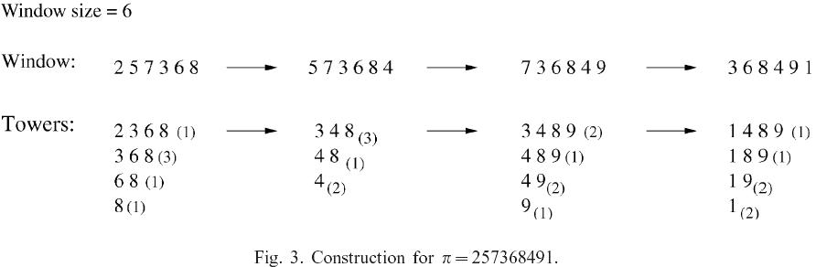
An Example
PR=(2,3,6,8)
m=(1,3,1,1)
d=(1,4,5,6)
σ=(1,2,3,4)
PR=(3,4,8)
m=(3,1,2)
d=(3,6,4)
σ=(1,3,2)
PR=(3,4,8,9)
m=(2,1,2,1)
d=(2,5,3,6)
σ=(1,3,2,4)
PR=(1,4,8,9)
m=(1,1,2,2)
d=(6,1,2,4)
σ=(4,1,2,3)
EXP
ADD
EXP
ADD
EXP
ADD
PR=(3,6,8)
m=(3,1,1)
d=(3,4,5)
σ=(1,2,3)
PR=(3,4,8)
m=(2,1,2)
d=(2,5,3)
σ=(1,3,2)
PR=(3,4,8,9)
m=(1,1,2,1)
d=(1,4,2,5)
σ=(1,3,2,4)
Red numbers will shift during the “ADD” operation, and blue color labels all i₁

Slide 13
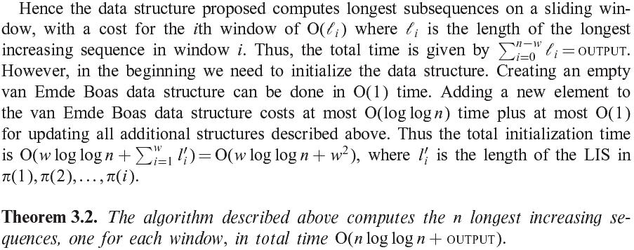
Analysis

Slide 14
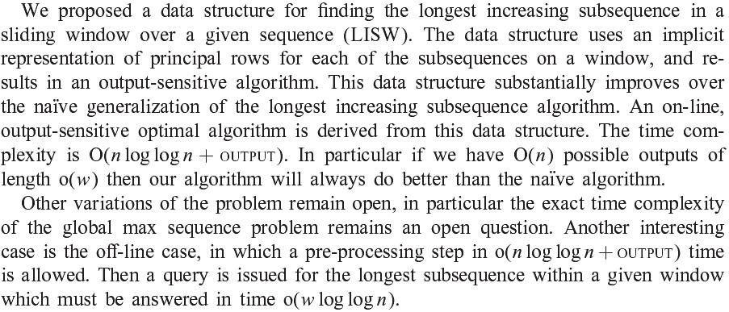
Conclusion

